Slide 1
java project library system
MAHMOUD ASHRAF MAHMOUD

Slide 2
1. Project Overview
The Library Management System is designed to manage the operations of a library, including user management (librarians and members), book inventory, and borrowing/returning transactions. The system is implemented in Java using object-oriented principles, ensuring modularity and ease of maintenance.

Slide 3
2. Key Features
User Roles:
Librarian: Manage book inventory, view all books,
and handle lending and returning of books.
Member: View available books, borrow books and return books.
Book Management:
Librarians can lend books.
Members can return books.
Borrowing Records:
The system keeps track of all borrowing transactions,
including details of the borrowed book and the member.

Slide 4
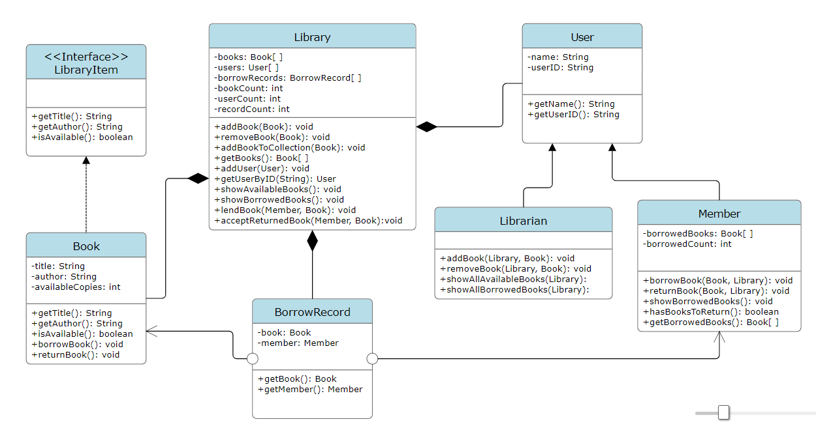
3. UML Class Diagram

Slide 5
4. System Workflow
Librarian Workflow
Login: Librarian logs in with their userID.
Lending and Returning: Librarian can lend books to members and accept returned books.
Member Workflow
Login: Member logs in with their userID.
View Books: Member views available books and borrowed books.
Borrowing: Member can borrow available books.
Returning: Member can return borrowed books.
Registration
Users can register as either a librarian or a member by providing necessary details (name, ID).

Slide 6
THANK YOU

